Slide 1
Polynomial and KNN Regression
Noble Xavier

Slide 2
POLYNOMIAL REGRESSION

Slide 3
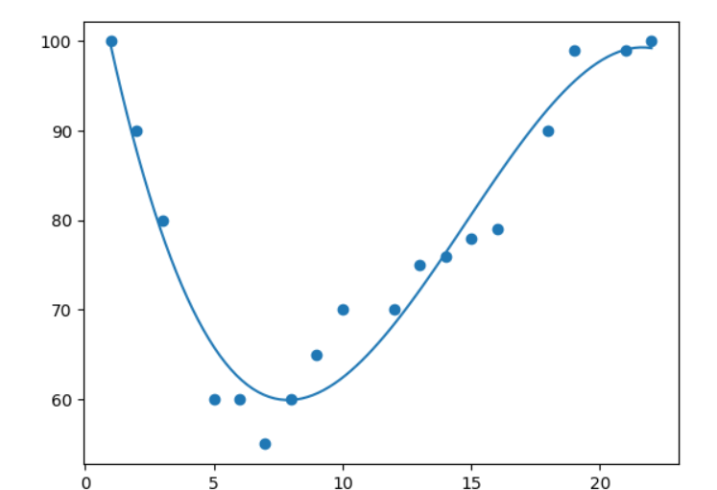
Polynomial Regression
Polynomial regression, like linear regression, uses the relationship between the variables x and y to find the best way to draw a line through the data points.
A real-life example of polynomial regression is predicting the trajectory of a rocket, where the relationship between time and position is nonlinear

Slide 4
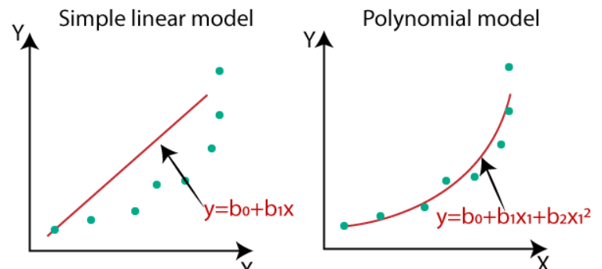
Difference Linear and Polynomial Regression
Polynomial linear regression is a special case of multiple linear regression where the independent variables are raised to different powers. This allows the model to fit non-linear relationships between the dependent and independent variables

Slide 5
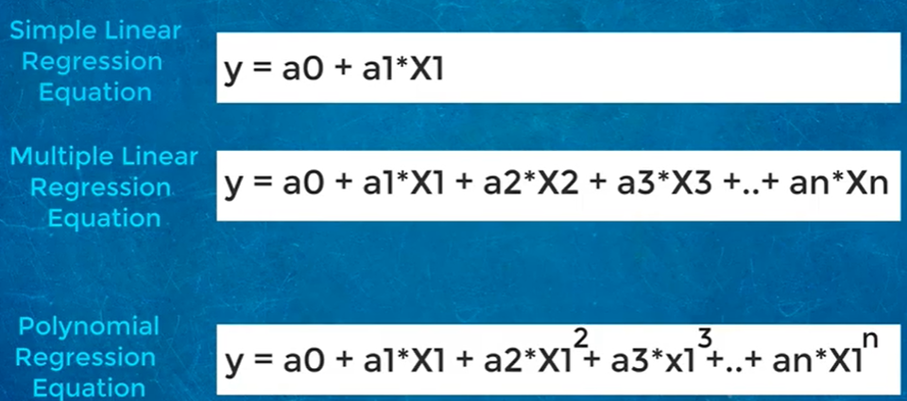
Polynomial Regression- Equation

Slide 6
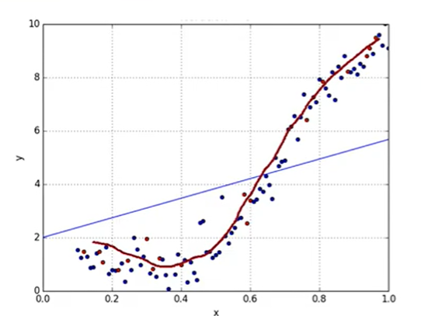
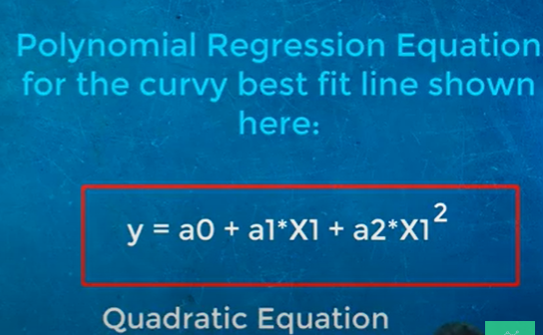
Polynomial Regression

Slide 7
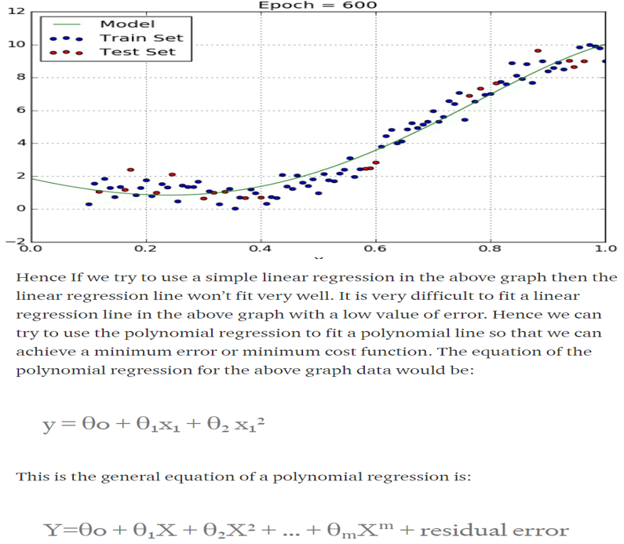
Polynomial Regression

Slide 8
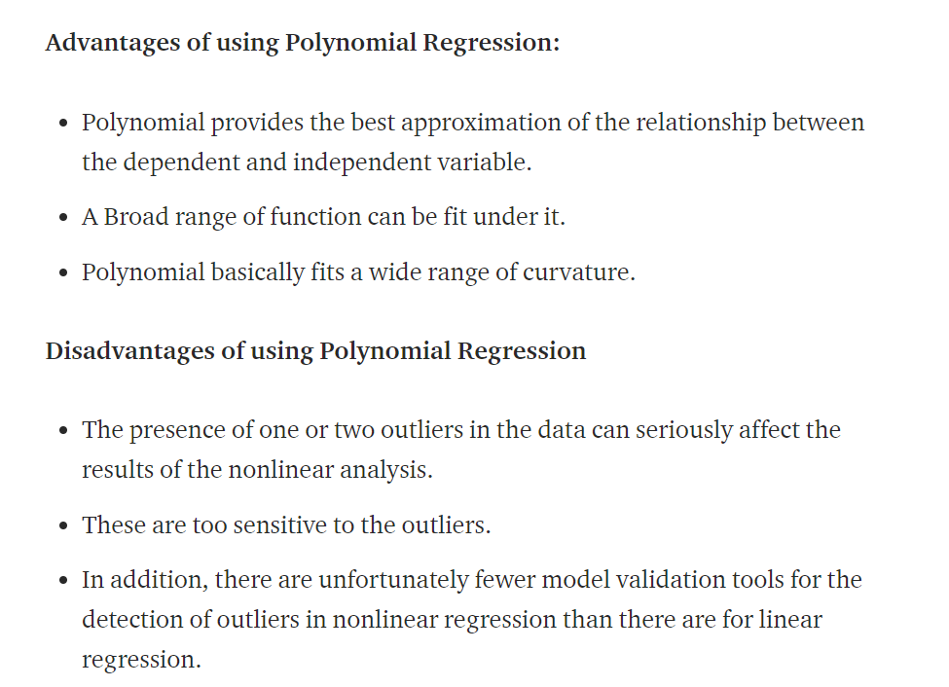

Slide 9
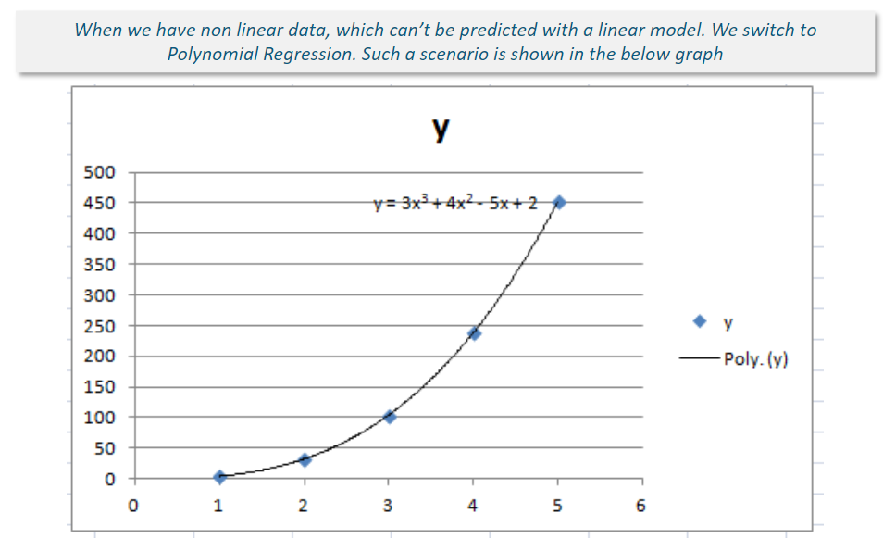

Slide 10
K-NEAREST NEIGHBORS(KNN)
(Regression)

Slide 11
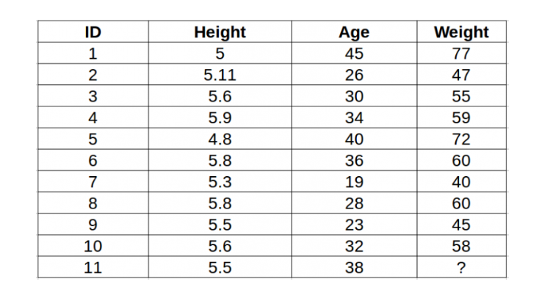
KNN (Regression)
Predict the Weight Based on Height and Age
(10 Samples, predict the Weight for the 11th Record)

Slide 12
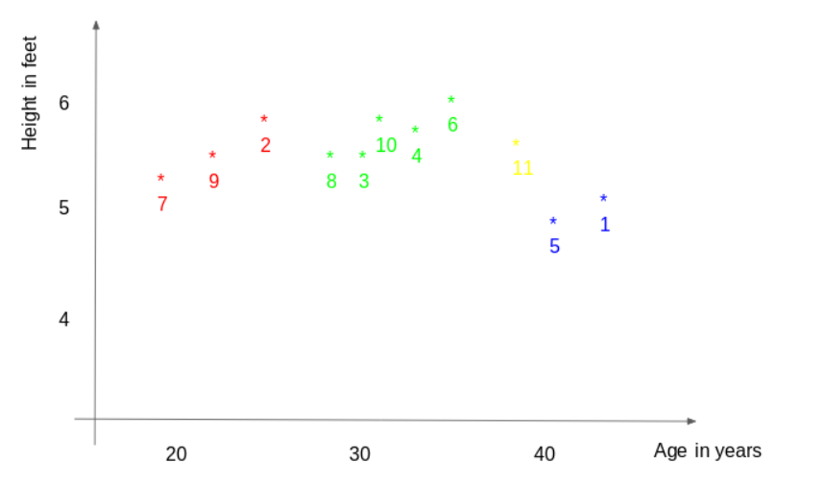
KNN (Regression)
Represent the Data as Graph- Yellow point ID 11 is the test point

Slide 13
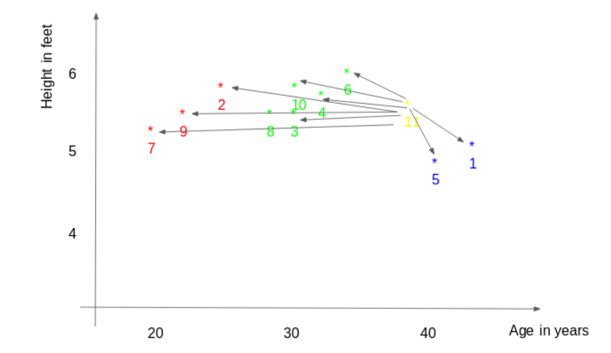
Working of KNN
Step 1 : Find the distance between the new point and each training point is calculated.

Slide 14
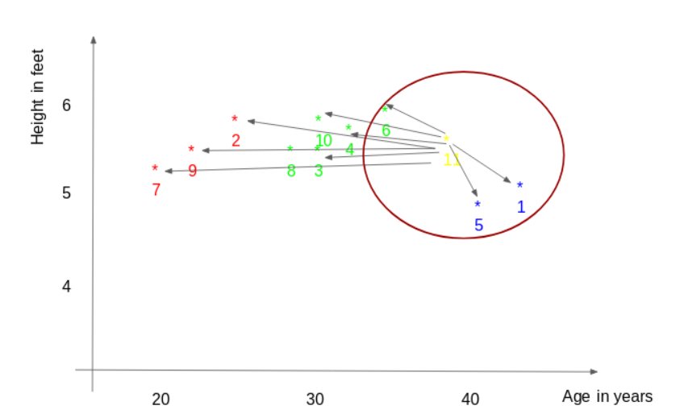
Working of KNN
Step 2 : The closest k data points are selected (based on the distance). In this example, points 1, 5, and 6 will be chosen if the value of k is 3.
Step3. The average of these data points is the final prediction for the new point. Here, we weight ID11 = (77+72+60)/3 = 69.66 kg.

Slide 15
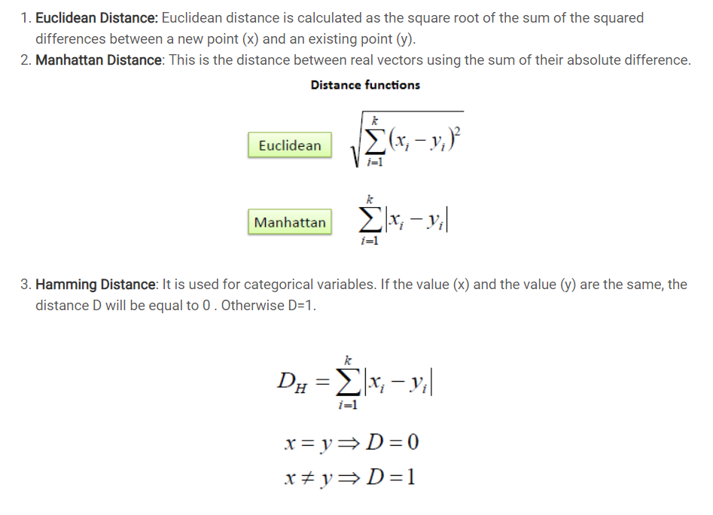
Distance Calculation

Slide 16
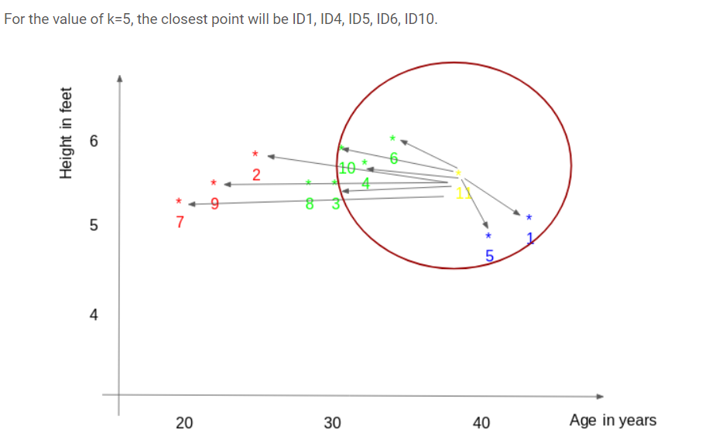
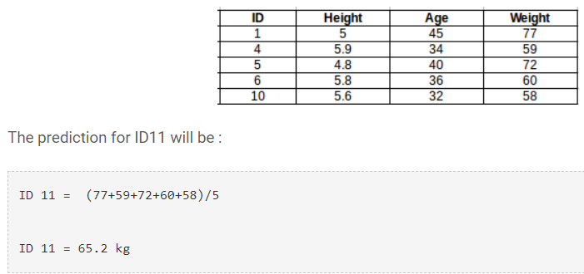
KNN
When K = 5 nearby points 1,4,5,6,10

Slide 17
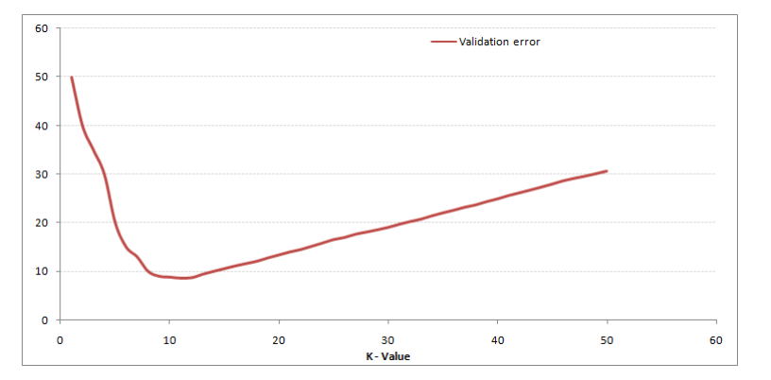
Optimum K Value
Plot the graph with RMSE value - The validation error curve reaches a minimum at a value of k = 9. This value of k is the optimum value of the model (it will vary for different datasets). This curve is known as an ‘elbow curve‘ (because it has a shape like an elbow) and is usually used to determine the k value.

